Slide 1

WELCOME TO MY PRESENTATION
Presentation
on
Business Model of SR Company
Md. Saedur Rahman
Batch: 04
Department of Public Administration
University of Barishal
Date: 02/06/2024

Slide 2

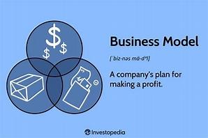
Business Model of SR Company

Slide 3
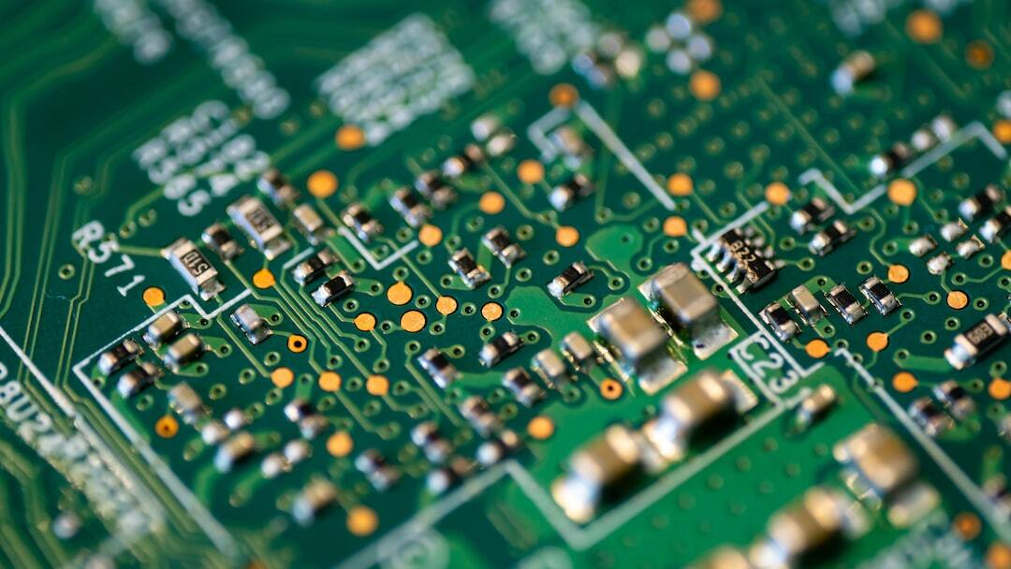
Overview of SR Company
Company Name: SR Company
  Industry: Electronics Manufacturing
  Core Competencies: Quality Control, Innovation, Customer Satisfaction
  Facilities: State-of-the-art manufacturing facilities with advanced technology
  Workforce: Highly skilled workforce ensuring performance and reliability

Slide 4
Products & Services
Consumer Electronics
Televisions
Audio systems
Personal Devices
Tablets
Wearables
Home Appliances
Refrigerators
Washing machines
Smart home devices
Accessories
Smart Phone
Smart Watch
AC
Microwave
Microwaves
Air conditioners
Custom electronic components for various industrial applications

Slide 5
Dashboard
Products Sales
Sales Performance: Strong demand, continuous innovation, and market expansion
Name | Total Sold | Total Unsold
Personal Devices | 60% | 40%
Electronics Devices | 75% | 25%
Accessories | 30% | 70%
Home Applications | 94% | 6%

Slide 6
Analysis of SR Company
  Annual Sales Growth: Significant increase in sales revenue over the past fiscal year
  Cost Management: Effective cost management through optimized cost structure and high standards of quality
  Financial Highlights: Total revenue, gross profit margin, and net profit

Slide 7
Video of SR Company

Slide 8
Conclusion
Final Thoughts: SR Company remains committed to innovation, quality, and customer satisfaction. Our focus on sustainable practices ensures long-term success and corporate responsibility.

Slide 9



Contact Us
+8801234567890
admin@SR.com
www.srcompany.com
Kornokathi, Barishal-8254, Bangladesh

Slide 10
THANK YOU

